Slide 1
Machine learning for the classification of unexploded ordnance (UXO) from electromagnetic data
Lindsey J. Heagy¹, Douglas W. Oldenburg², Fernando Pérez¹, Laurens Beran³
¹University of California Berkeley, ²University of British Columbia, ³Black Tusk Geophysics

Slide 2
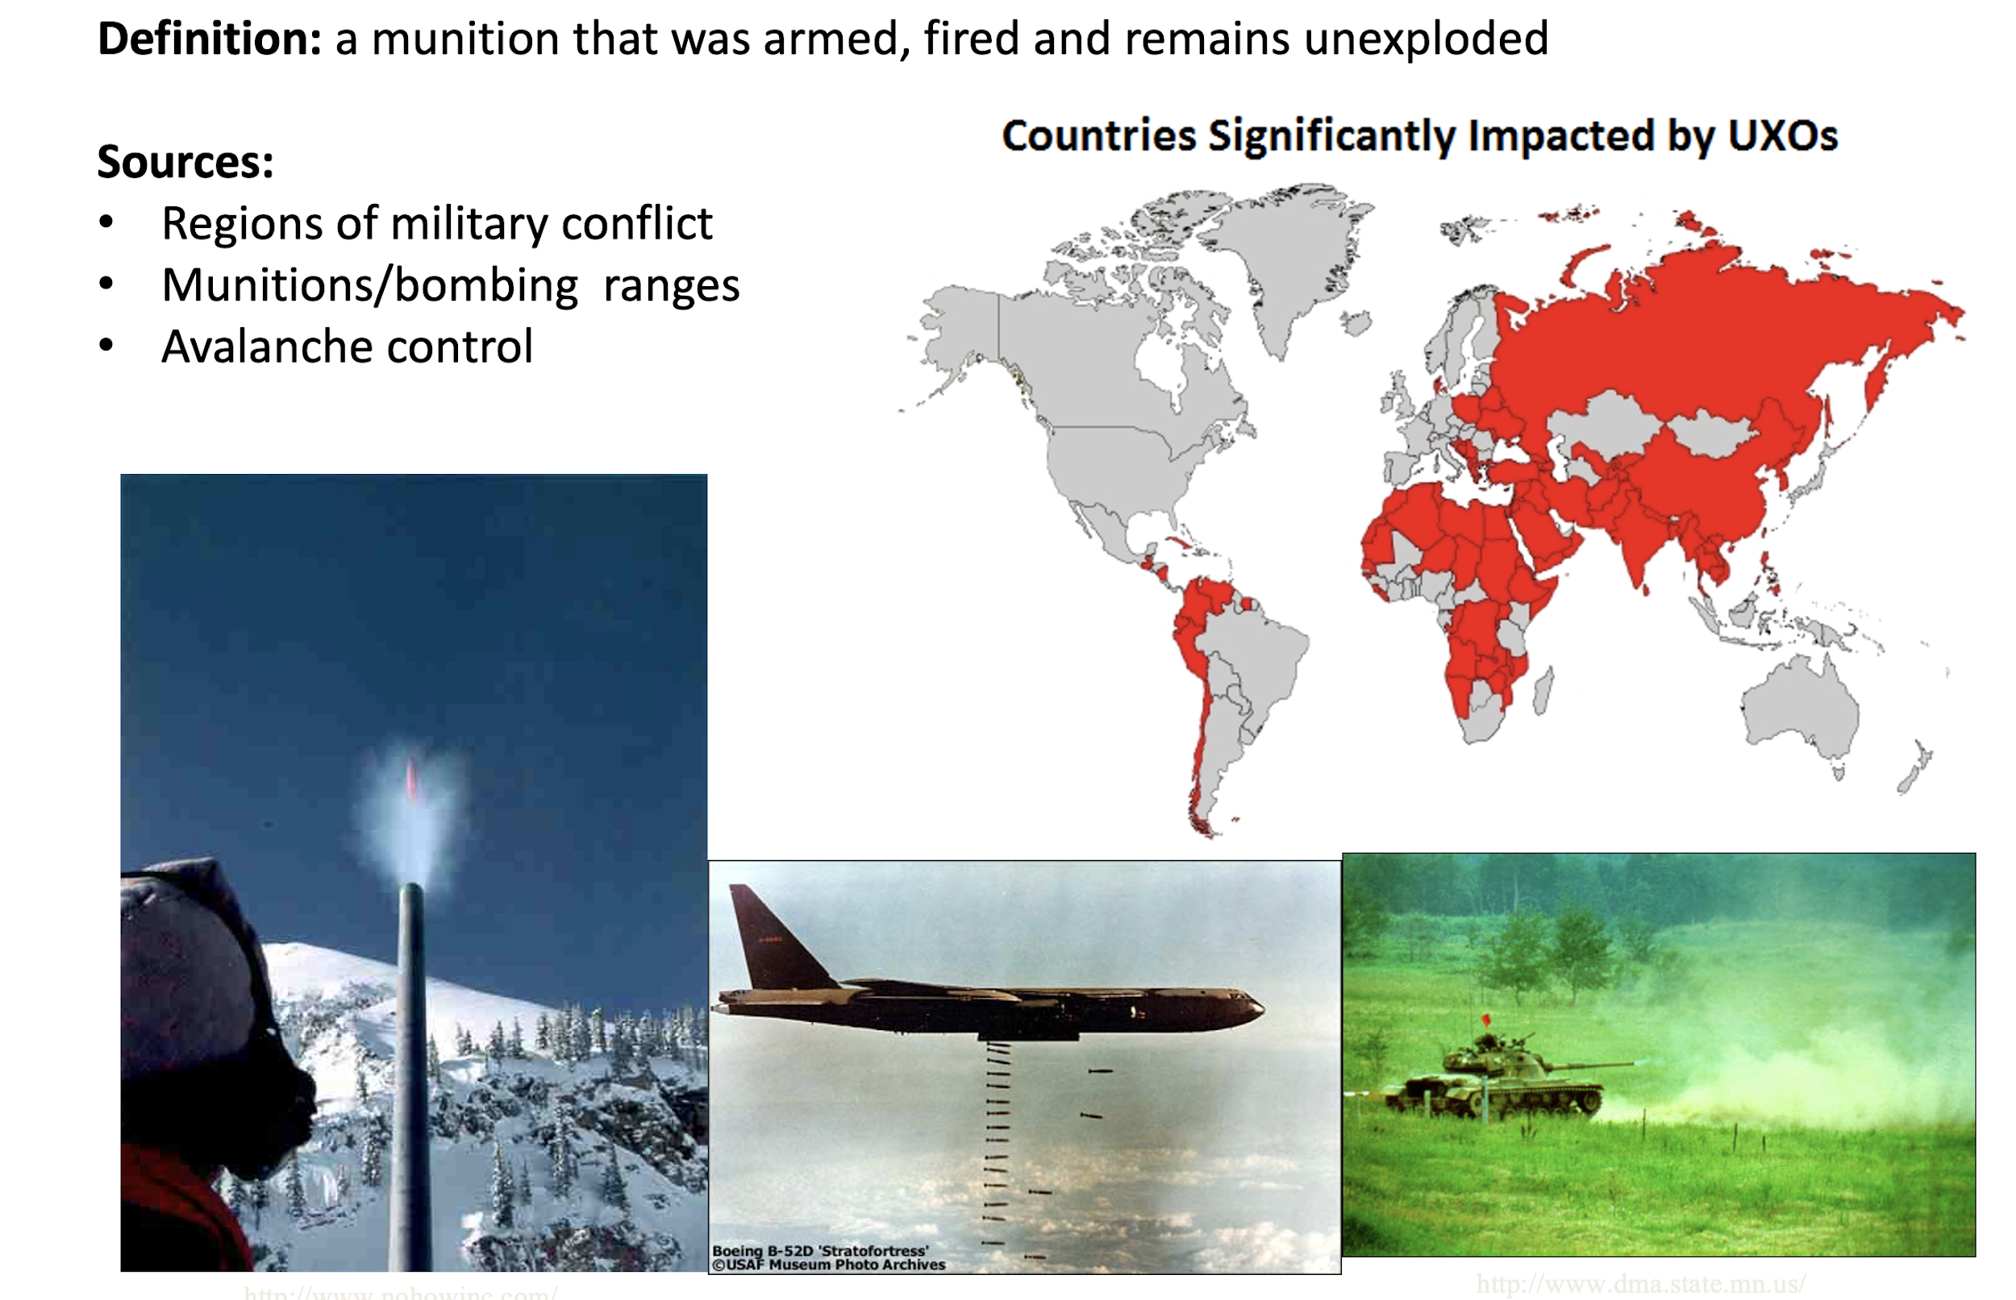
Unexploded ordnance (UXO): A global problem
Definition: a munition that was armed, fired and remains unexploded
Sources:
Regions of military conflict
Munitions and bombing ranges
Avalanche control
Countries significantly impacted by UXO
Notes:
UXO: a munition armed, fired and remains unexploded -- presents a hazard
Sources: military conflict, training grounds, even avalanche control
Impacts much of the world

Slide 3
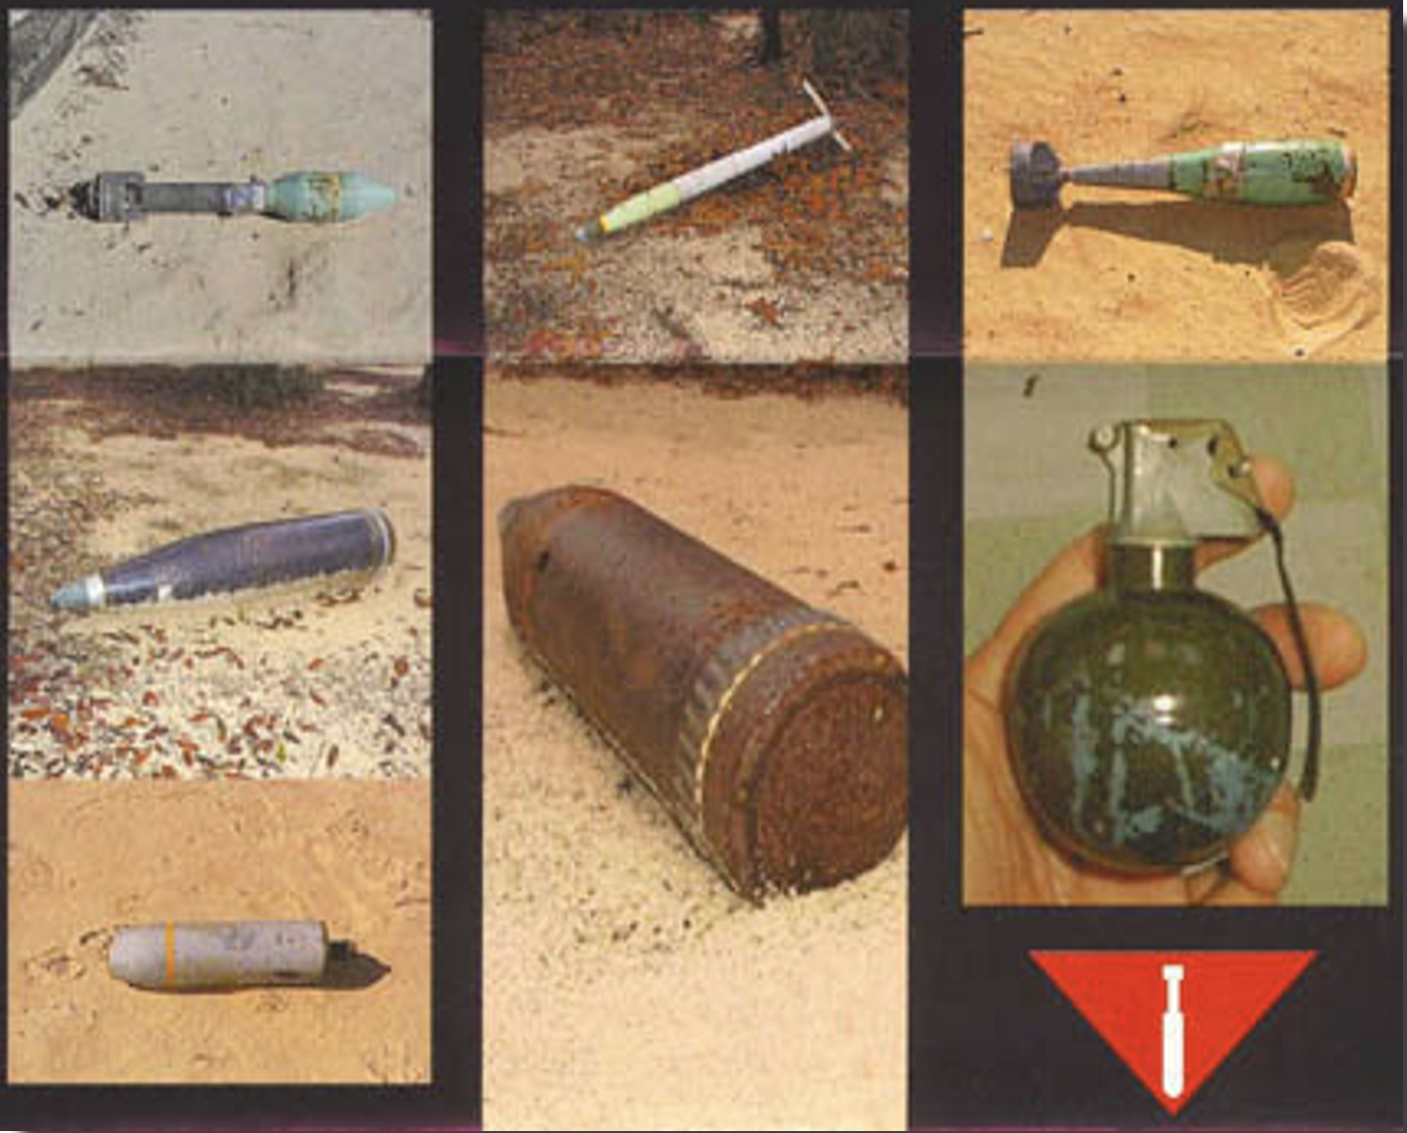
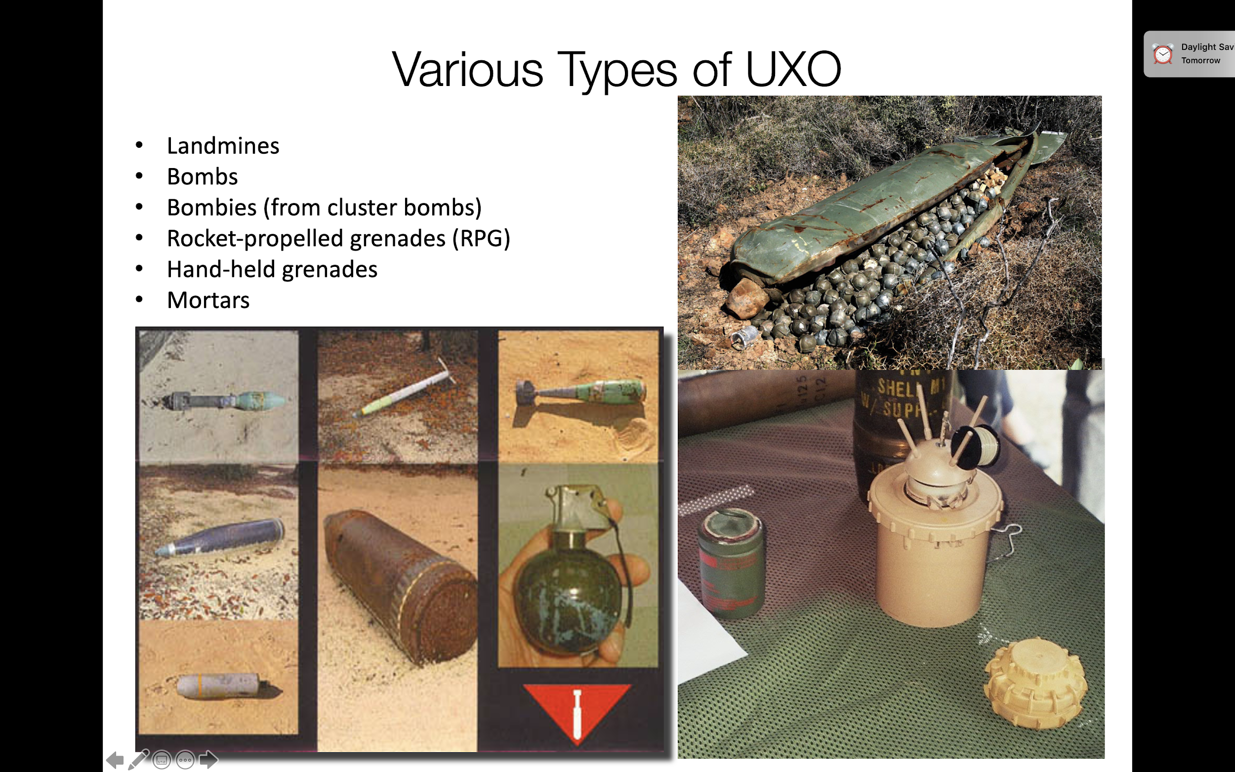
Various types of UXO
Landmines
Bombs
Bombies (from cluster bombs)
Rocket-propelled grenades (RPG)
Hand-held grenades
Mortars
Notes:
Bombies / cluster bombs a significant problem in Afghanistan, Vietnam

Slide 4
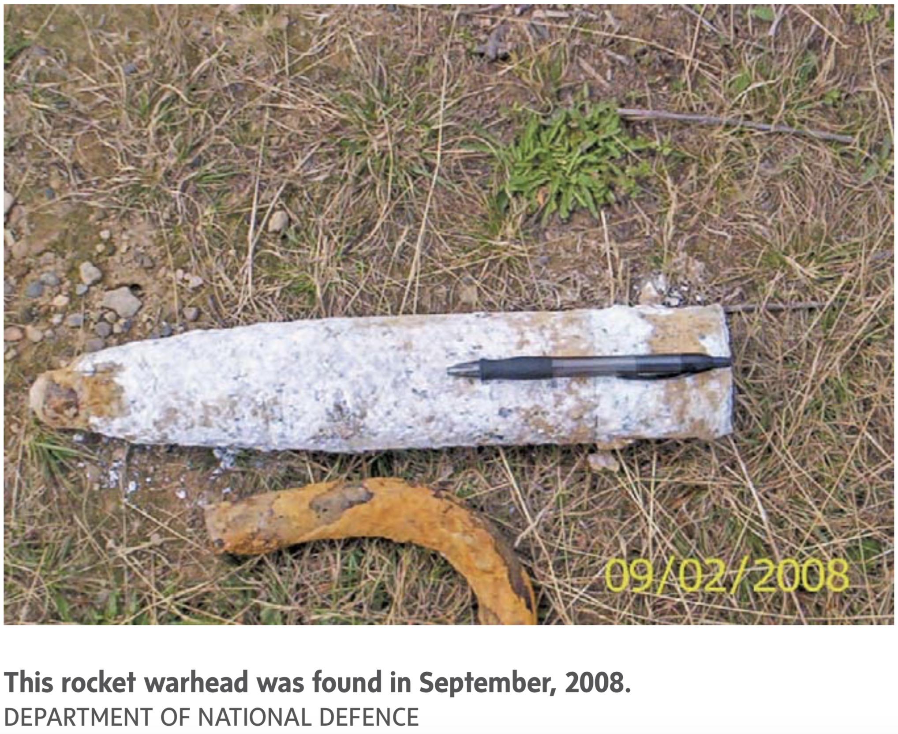
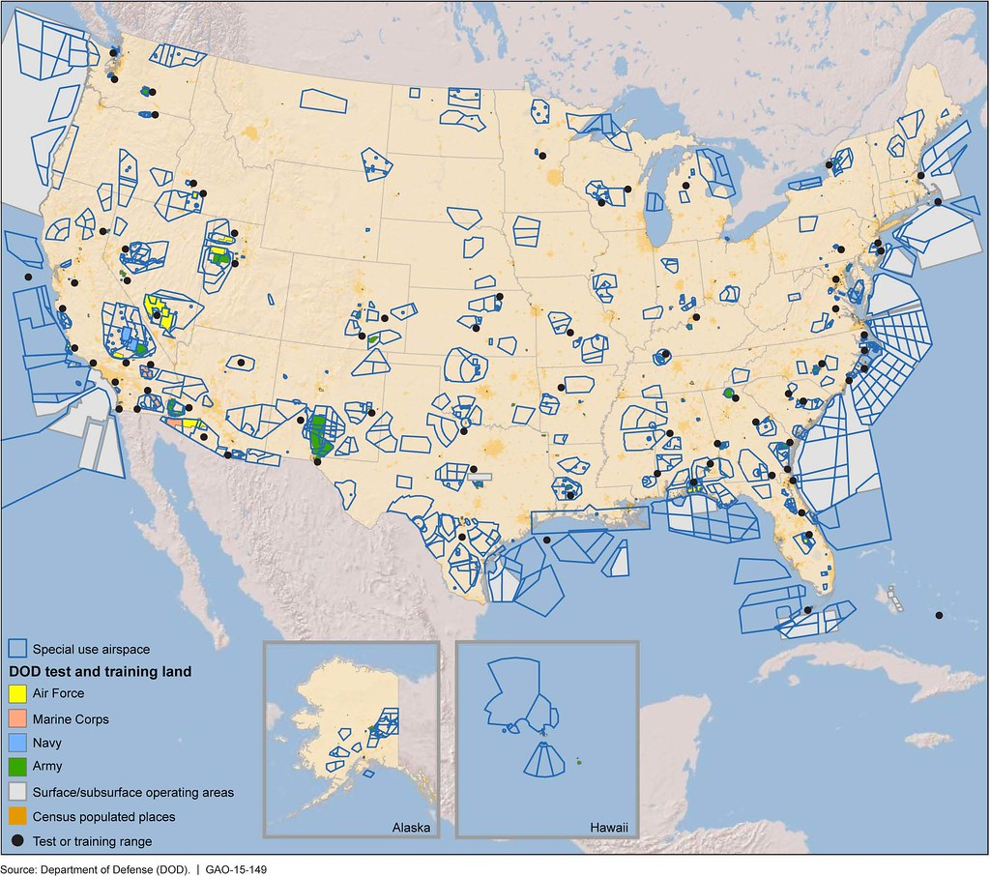
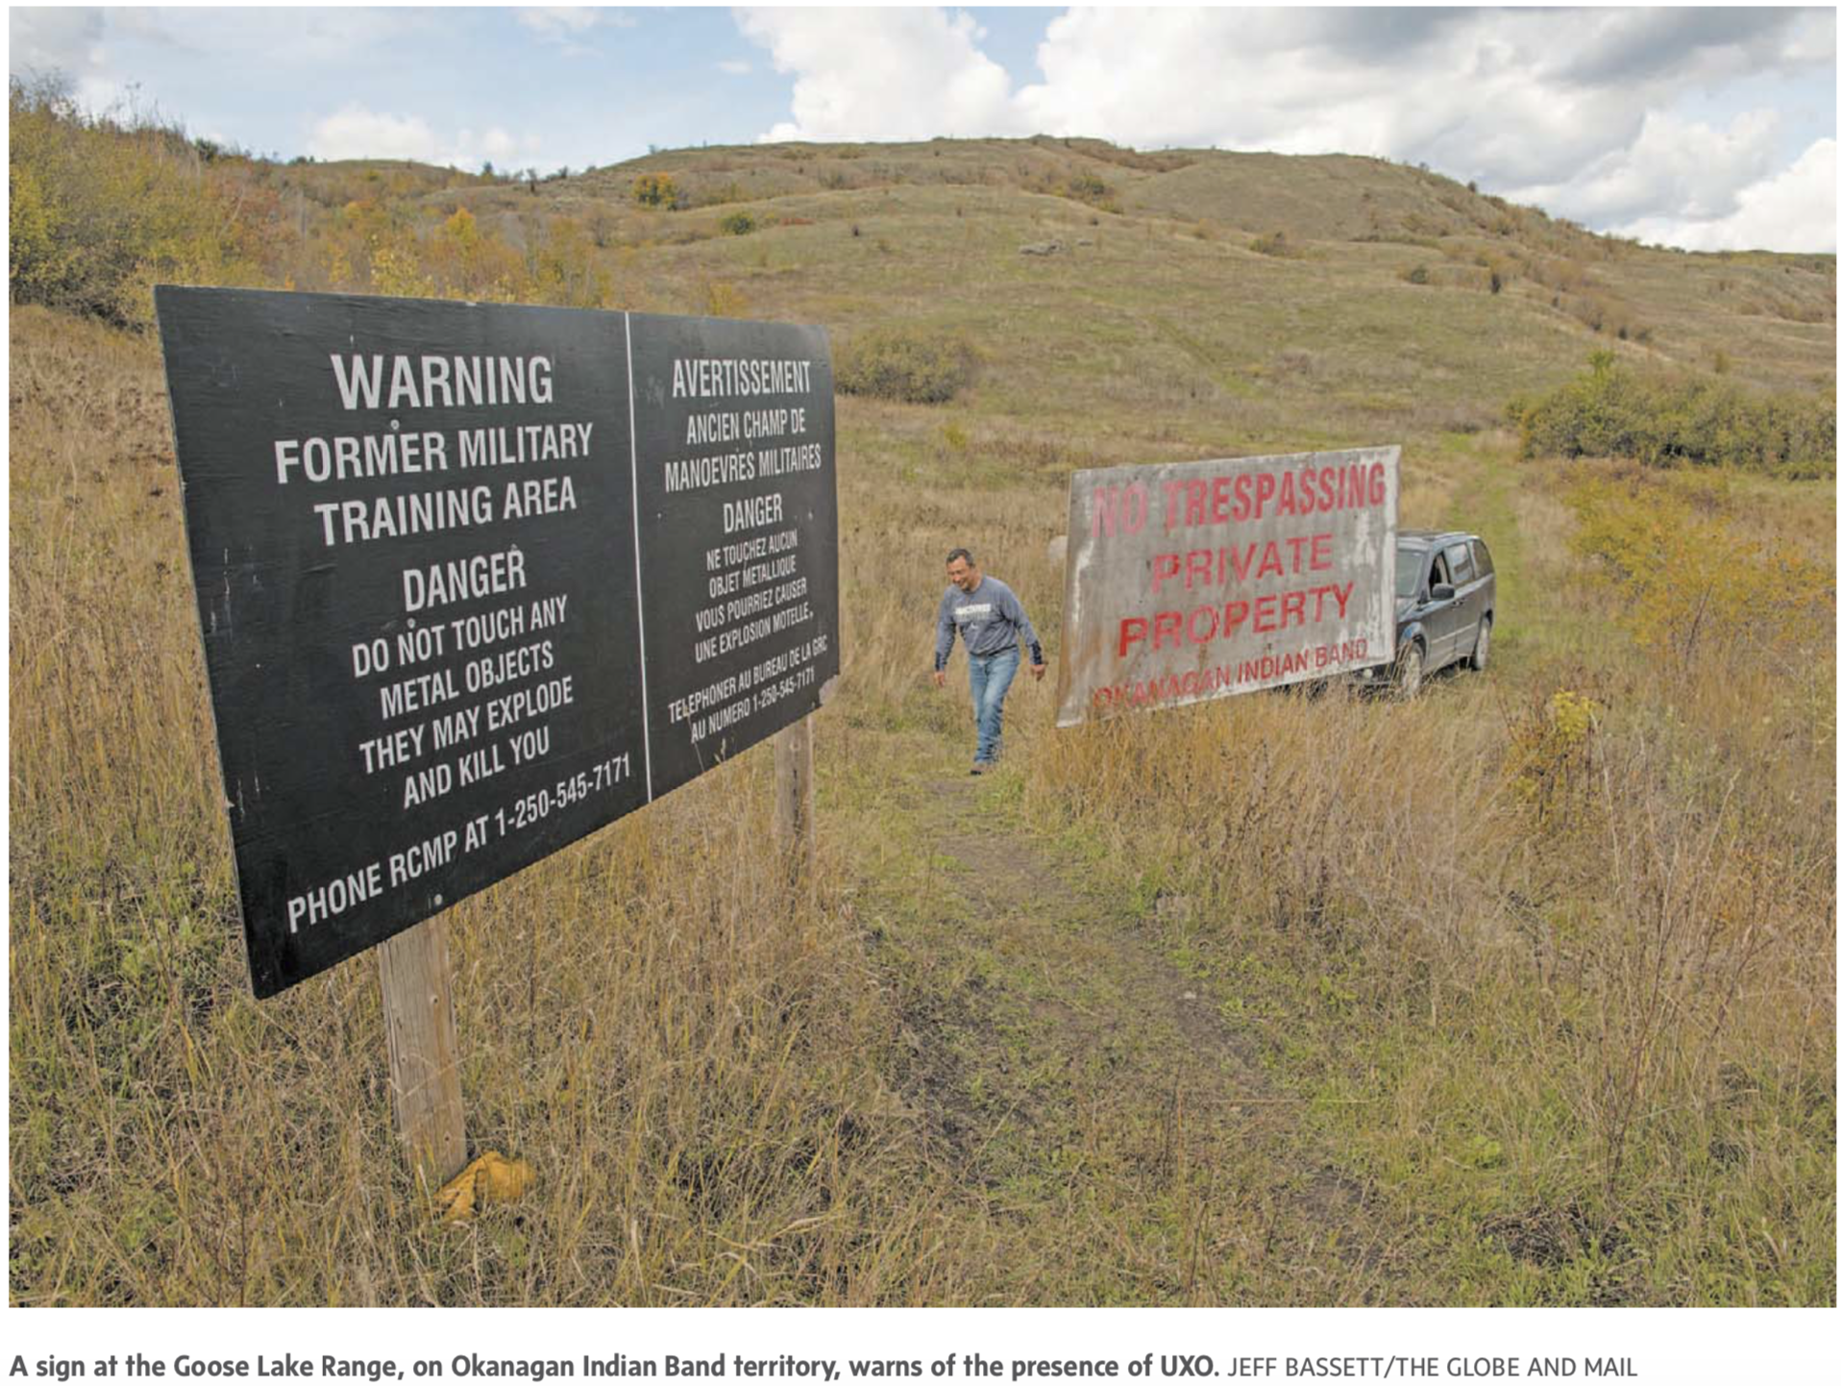
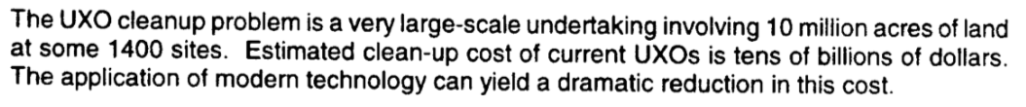
In the USA
?
US Department of Defence UXO Task Force Report, 2003
Notes:
In the US alone -- estimated to be a problem on the scale of ~10s of billions of dollars
One particular example: Kaho’olawe: used as a bombing range for 50 + years (starting in 1925)

Slide 5
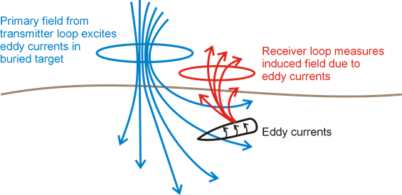
Electromagnetics
Notes:
Basic experiment: time-varying current through a transmitter loop → produces a time varying magnetic field → induces eddy currents in conductive targets → generate their own magnetic field → measured at a receiver loop
For the following, we consider TDEM experiments

Slide 6
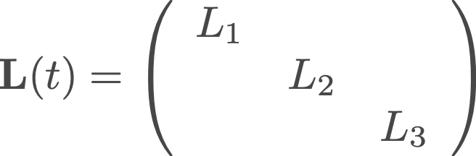
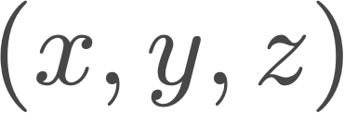
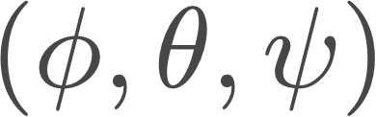
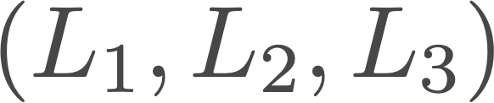
Modelling the electromagnetic response: UXO
Approximate Physics Model
data
transmitter
receiver
rotation matrix
primary magnetic field
secondary magnetic field
polarization matrix
Euler angles
Unknowns
UXO location
orientation
polarizations
Notes:
Use an approximate physics model:
Parameterize the ordnance object in terms of polarizabilities, location and orientation

Slide 7
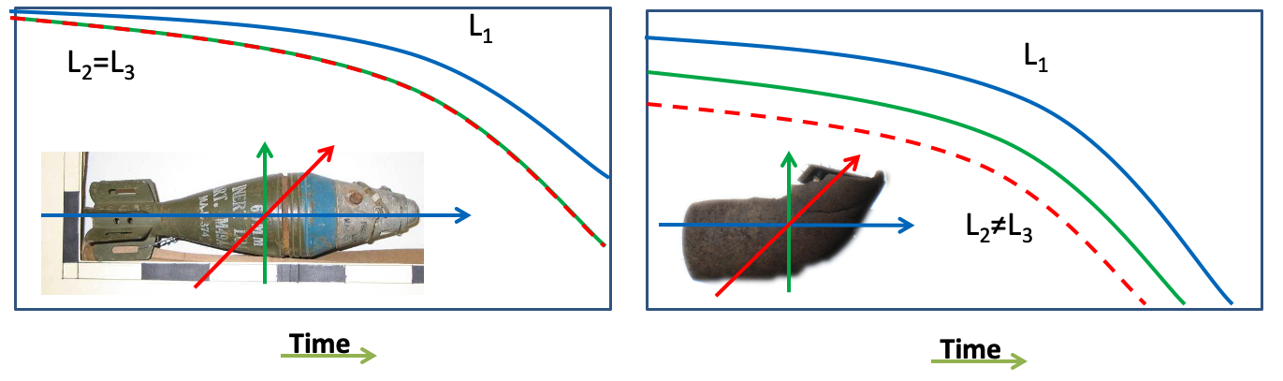
Modelling the electromagnetic response: UXO
UXO generally distinguished by:
large amplitude, slow-decaying primary (L1) polarizability
equal secondary polarizabilities (L2=L3)
transmitter
receiver
primary magnetic field
secondary magnetic field
UXO
Not UXO

Slide 8

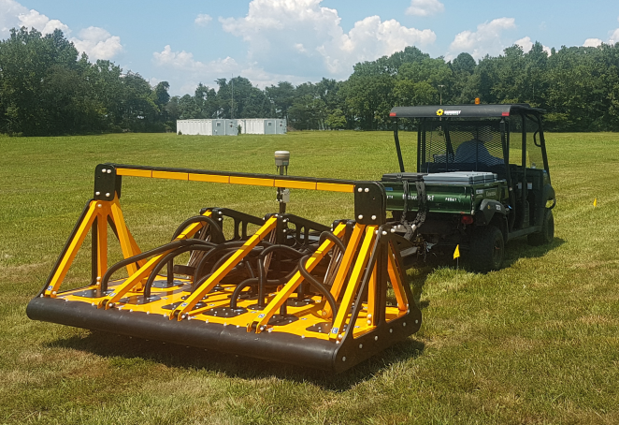
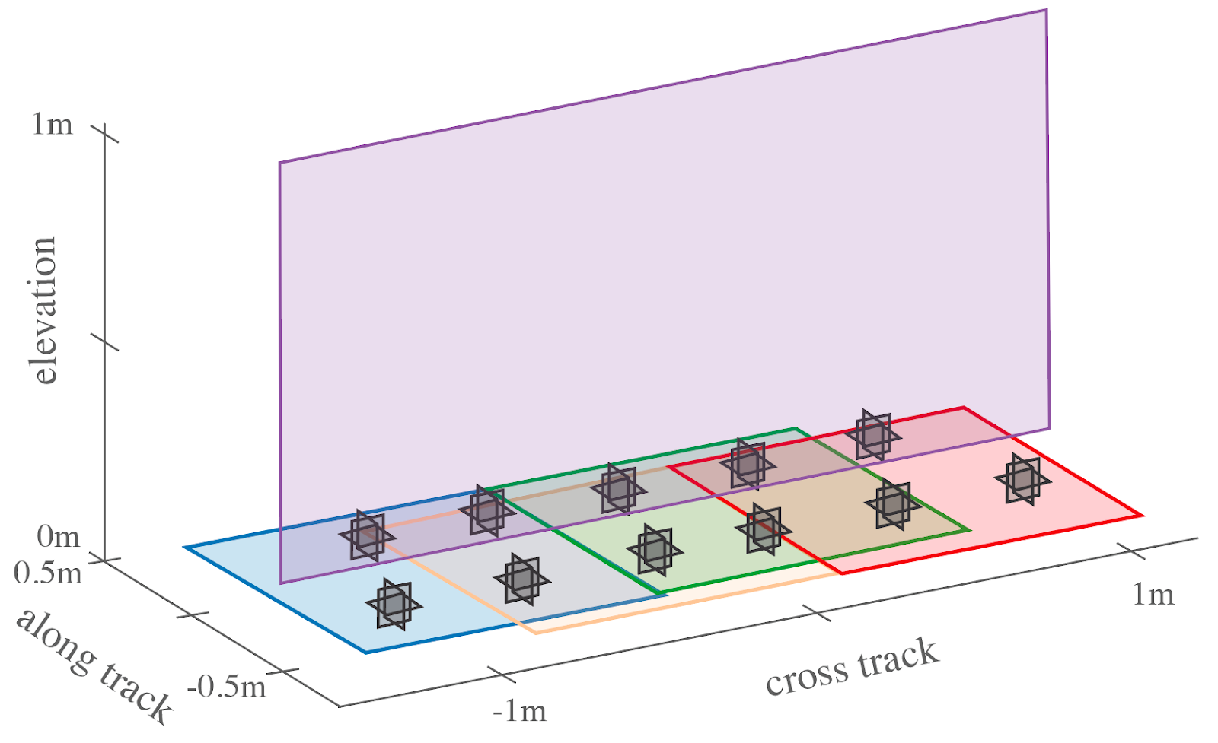
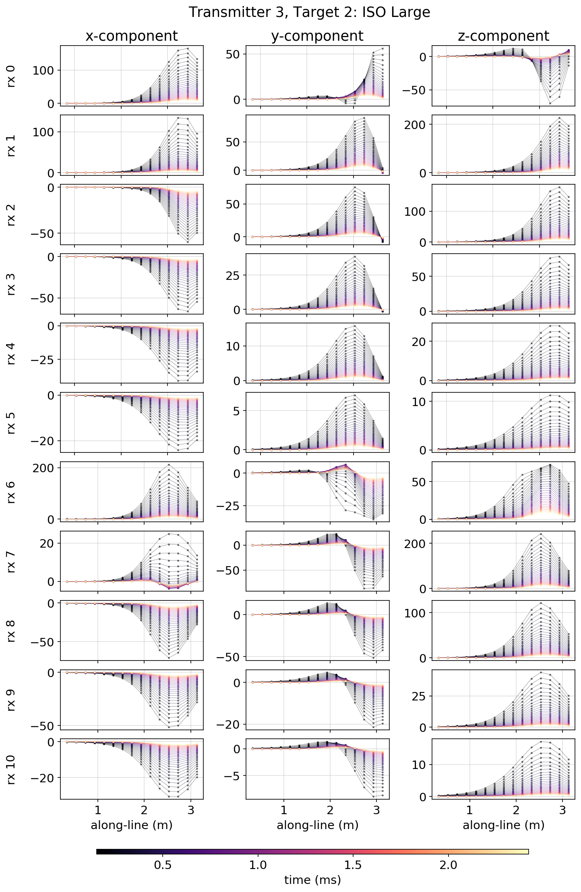
Survey and Data
UltraTEM system:
5 transmitters
11 receivers (3-component)
27 time channels
Image source: http://www.btgeophysics.com/UltraTEMBasicDescriptionv2.pdf

Slide 9
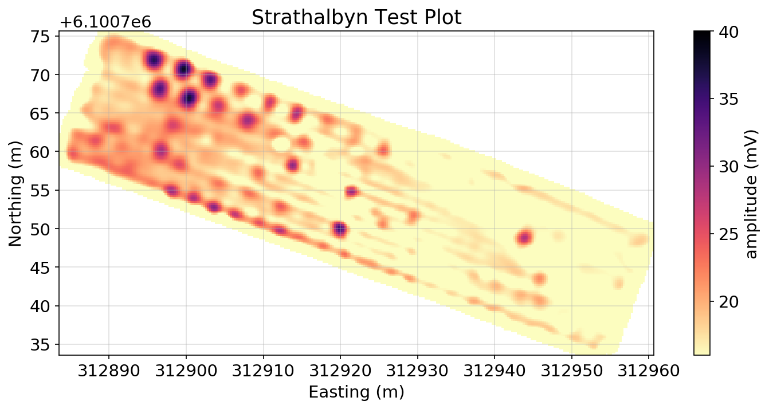
Current methodology
Digital Geophysical Map
Target picking
Cued Interrogation
Feature estimation
Quality Control
Classification
UXO
Not UXO
Notes:
With the UltraTEM we are skipping the Cued interrogation step and doing one-pass classification

Slide 10
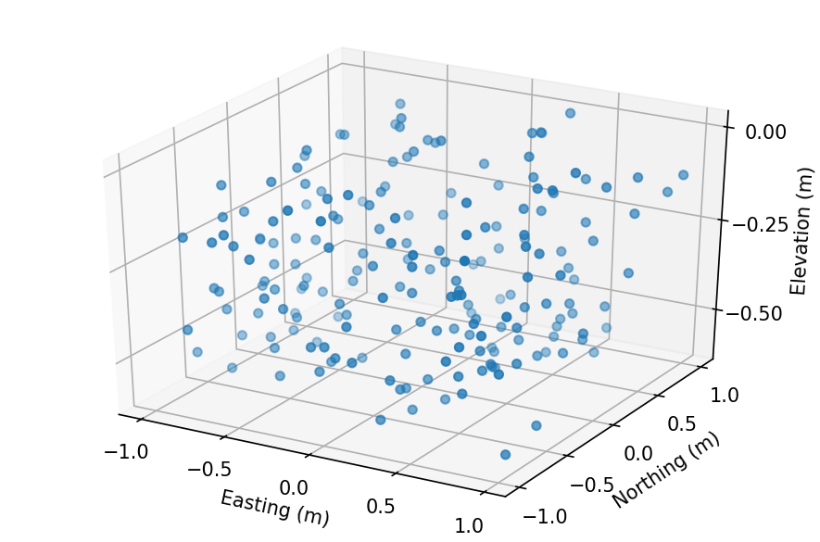
Current methodology
Digital Geophysical Map
Target picking
Cued Interrogation
Feature estimation
Quality Control
Classification
Populate region of interest with random seed locations
For a each seeded location:
Inversion 1: estimate
Evaluate data fit, remove points with poor fit
Inversion 2: decompose and isolate
For each : Fingerprint with library of known ordnance
Make a dig list
Notes:
V. nonlinear inversion,

Slide 11

Candidate for convolutional neural networks?
Features of EM data for UXO detection / classification:
Available library of ordnance objects with polarizations
Access to labeled field data sets
Convolutional neural networks
Workhorse in deep learning
Convolutional filters look at spatial / temporal features in the data
https://towardsdatascience.com/a-comprehensive-guide-to-convolutional-neural-networks-the-eli5-way-3bd2b1164a53

Slide 12
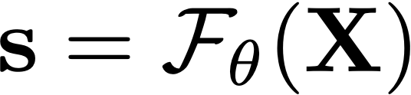
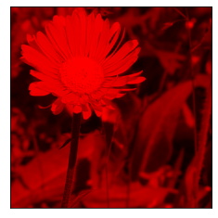
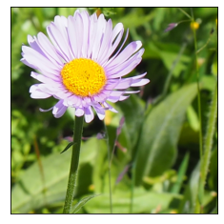
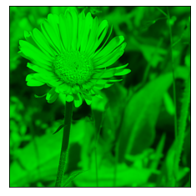
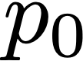
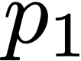
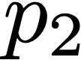
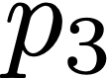
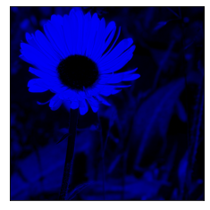
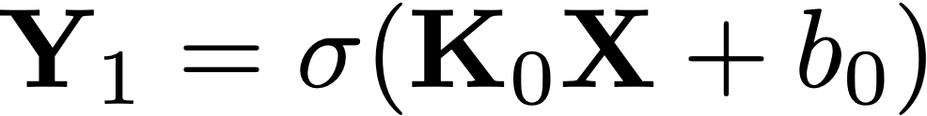
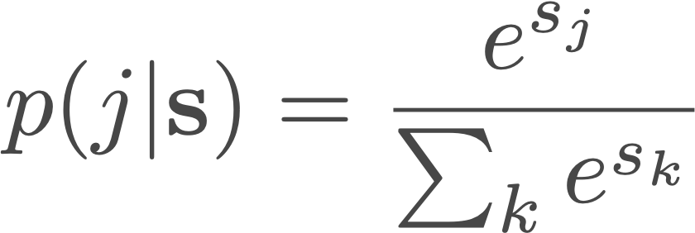
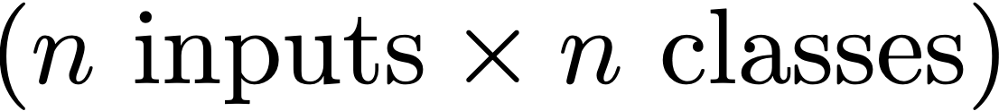
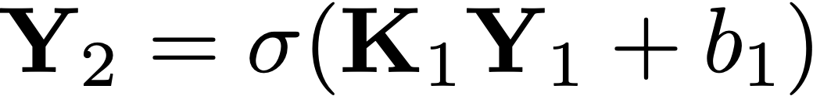
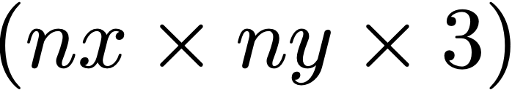
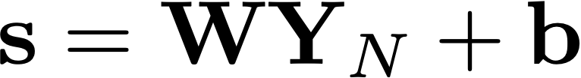
Neural networks: a brief overview
Supervised classification problem
provided data with labels, construct a function (network) that outputs labels given input data
Input
Features
Neural network
Class probabilities
Convolutional layers
flower
...
...
dog
via softmax
Linear classifier
class
all classes
Follows notation of Haber and Ruthotto

Slide 13
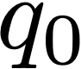
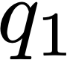
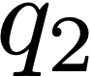
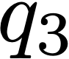
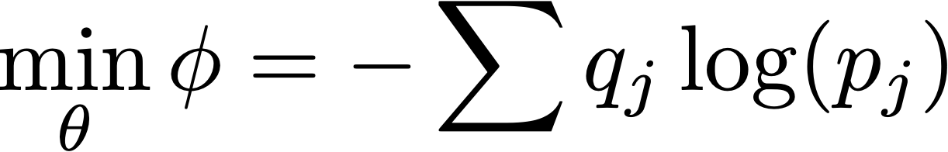
Neural networks: a brief overview
Training
define an optimization problem to estimate network parameters
Input
Features
Neural network
Class probabilities
all trainable parameters
predicted
Convolutional layers
true
Linear classifier
Measure: cross entropy loss
Follows notation of Haber and Ruthotto
Notes:
q: [0, 1]
0 <= p <= 1, log is always negative, log(1) = 0, log(<1) is negative

Slide 14
Neural networks: a brief overview
Translating to the UXO problem
What are the inputs?
Input
Features
Neural network
Class probabilities
predicted
Convolutional layers
true
Linear classifier
Measure: cross entropy loss
Follows notation of Haber and Ruthotto

Slide 15
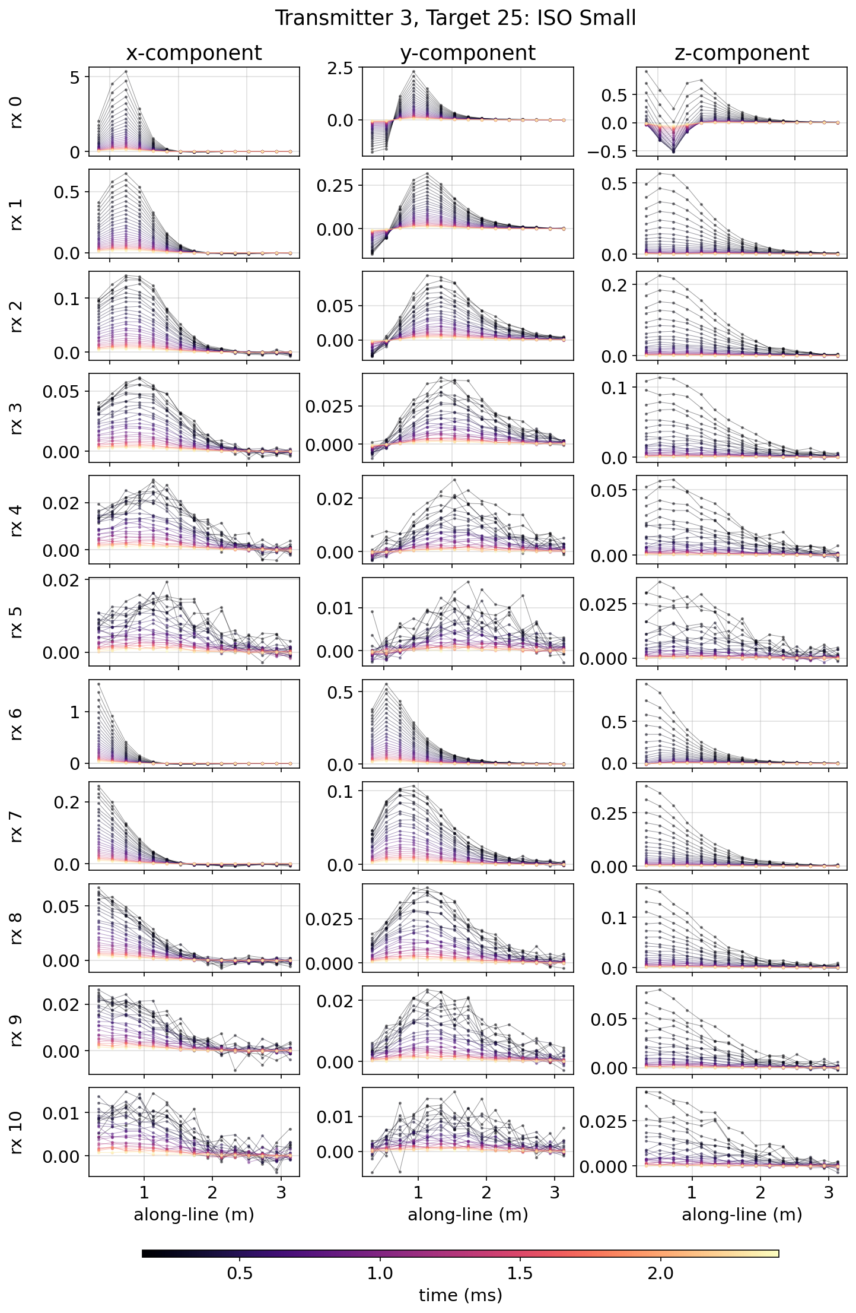
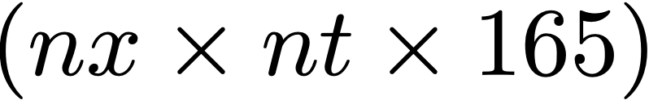
Neural networks: a brief overview
Translating to the UXO problem
What are the inputs?
Input
Features
Neural network
Class probabilities
predicted
Convolutional layers
true
Linear classifier
Measure: cross entropy loss
Follows notation of Haber and Ruthotto

Slide 16
CNN Setup: What are the data
UltraTEM data:
165 transmitter - receiver combinations
27 time-channels
# soundings in a given along-line distance (3m window, 15 locations)
...

Slide 17
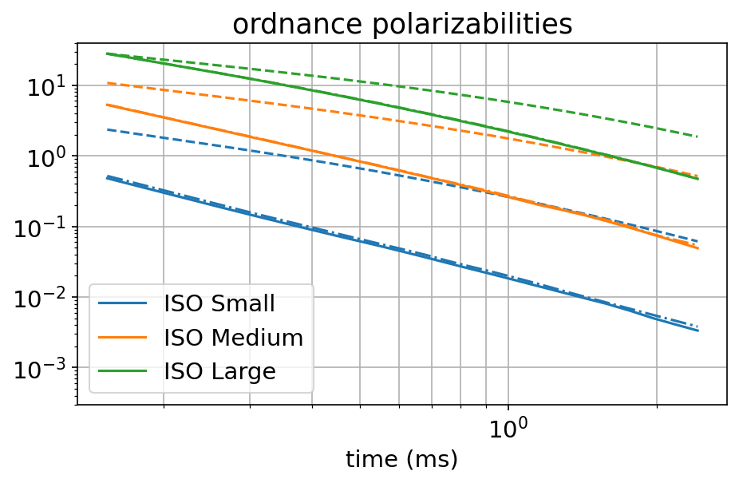
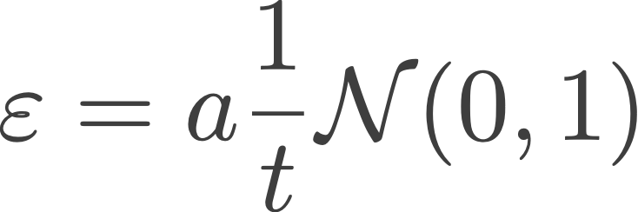
Training data
Thousands of realizations
Training: ~8k
Test & Validation: ~1k
For each realization, randomly assign:
Target class
Location
Orientation
Noise level
Target Classes:
Background
Small ISO
Medium ISO
Large ISO
Clutter (20mm, spherical objects)
0.5m
4m
3m

Slide 18
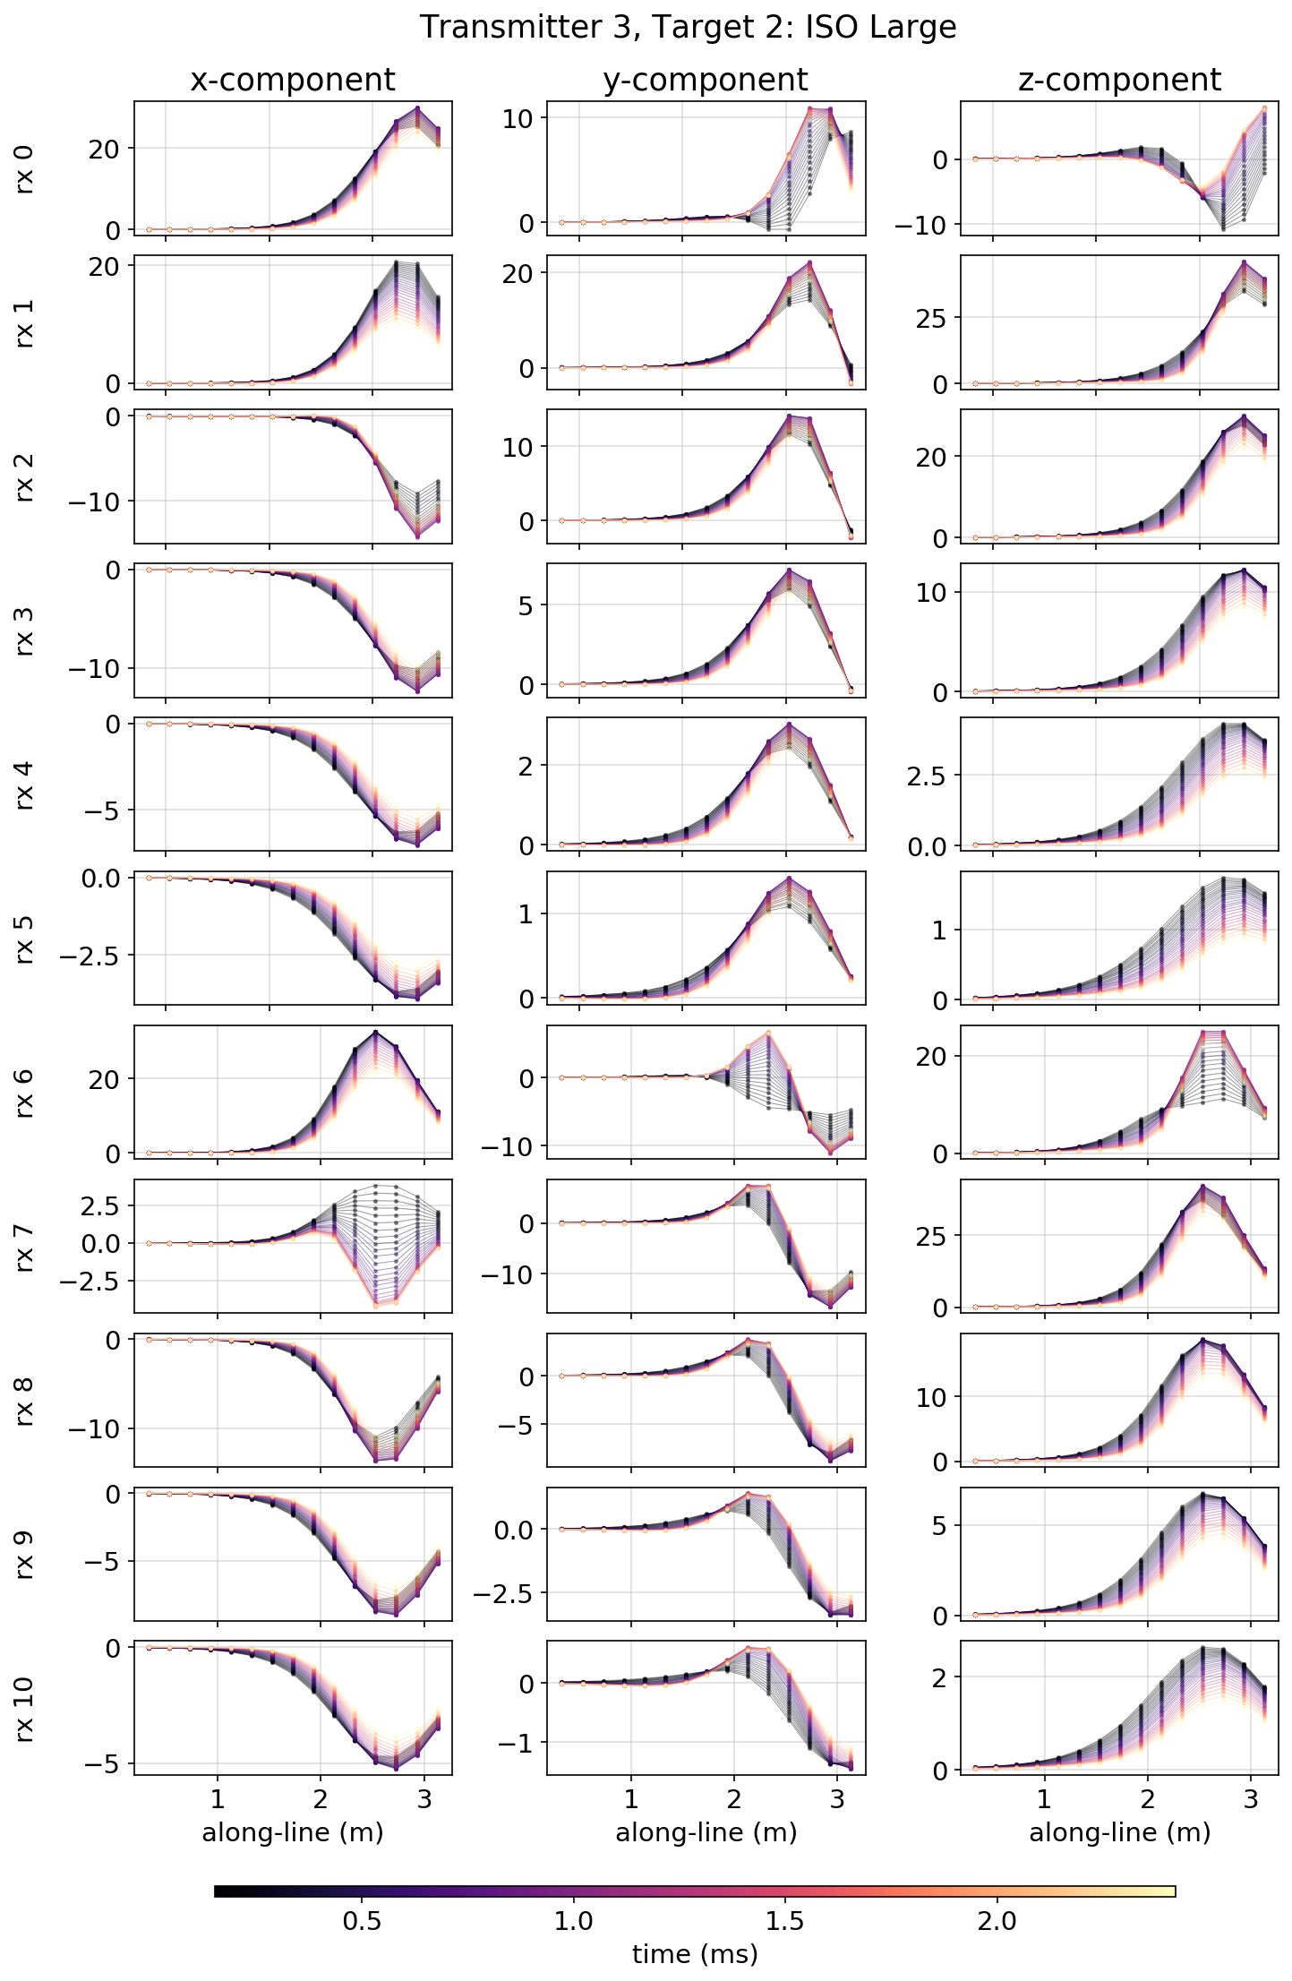

Data normalizations
2 steps:
Scale each data as a function of time for each channel (multiply by t)
Normalize amplitude across all channels to have maximum amplitude 1
Simulated
Scaled: time
Scaled: max amplitude=1

Slide 19
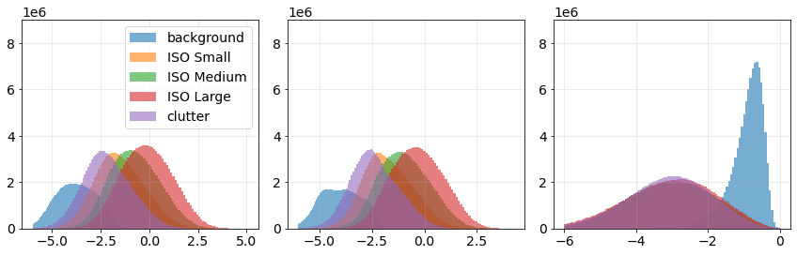
Data normalizations
2 steps:
Scale each data as a function of time for each channel (multiply by t)
Normalize amplitude across all channels to have maximum amplitude 1
Simulated
Scaled: time
max amplitude=1
log₁₀(amplitude)
log₁₀(amplitude)
log₁₀(amplitude)

Slide 20
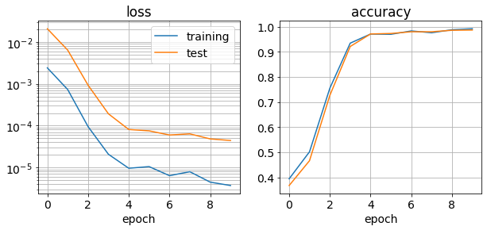
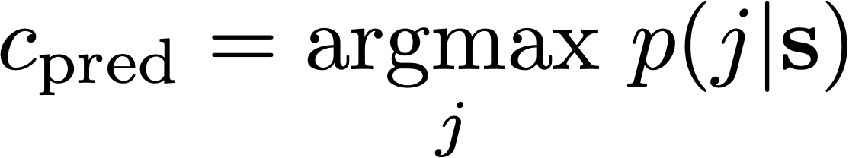

Training the CNN
Convolutional Network
Class probabilities
Classification
Training problem (use stochastic gradient descent)
outputs
network parameters
input features
class
all classes

Slide 21
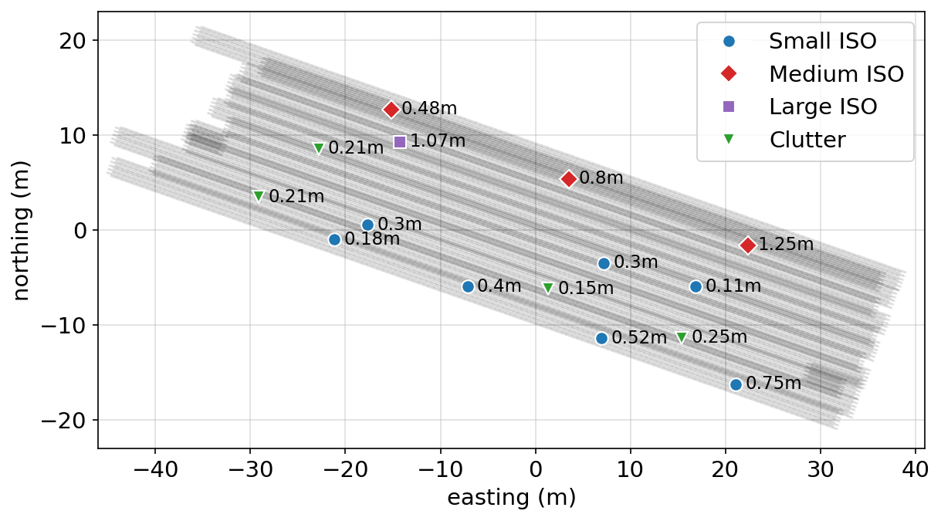
Synthetic survey

Slide 22
Synthetic survey
0%
0%
0%
0%
100%
Background

Slide 23
Synthetic survey
68%
6%
0%
26%
0%
Background

Slide 24
Synthetic survey
100%
0%
0%
0%
0%
Background

Slide 25
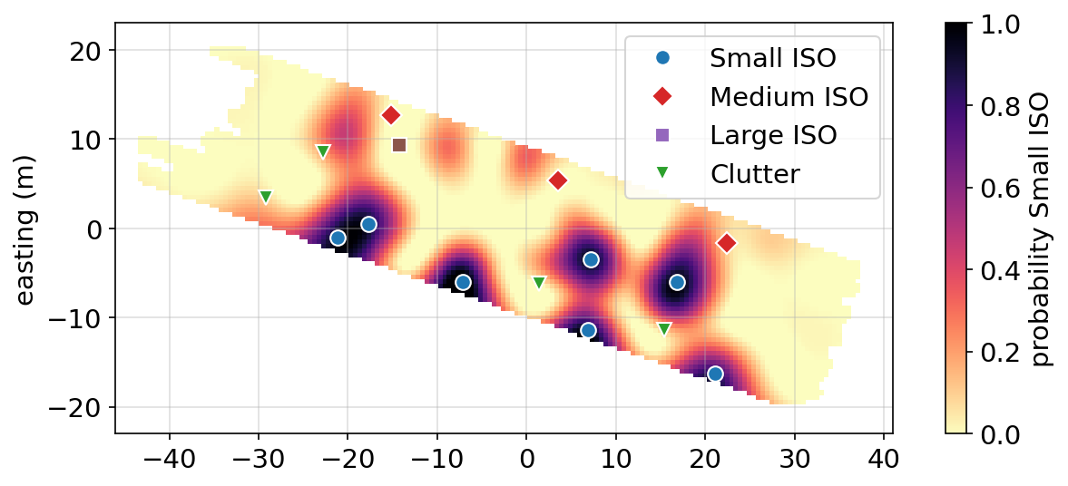
Synthetic example: Small ISO

Slide 26
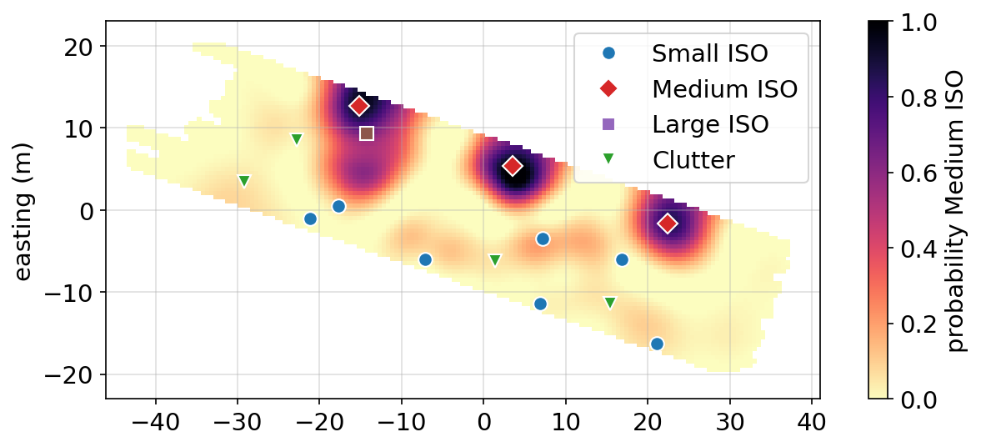
Synthetic example: Medium ISO

Slide 27
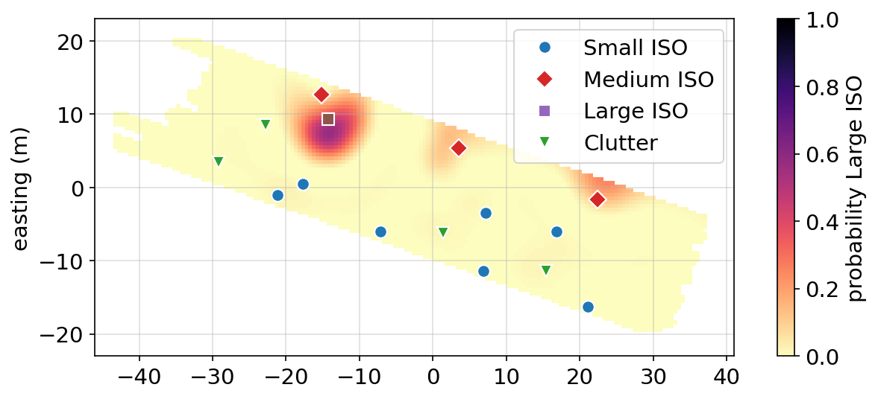
Synthetic example: Large ISO

Slide 28

Synthetic example: clutter

Slide 29

UXO: Open avenues & next steps
Results demonstrate:
Proof-of-concept for classification of UXO directly from data
Questions and next steps
Constructing clutter model: what else should we include?
Multi-object scenarios
Exploring behaviour in challenging geologic settings (e.g. magnetic soils)
Neural Network architecture:
Input data: other features to input?
Regularization or parameterization of network parameters?
How to integrate information from ML with traditional analysis to make clearance more effective and less costly?

Slide 30



Thank you
@lheagy
lheagy@berkeley.edu
@lindsey_jh
https://github.com/simpeg-research/heagy-et-al-2020-uxo-seg

